Slide 1
Reference variables, pass-by-reference and return-by-reference

Slide 2
Outline
In this lesson, we will:
  Learn about reference variables
    Aliases to other assignable items (lvalues)
  See how to use this for pass-by-reference
    Changing arguments—not parameters—inside of functions
  Useful for updating arguments that hold values
  We will also see return-by-reference

Slide 3
Reference local variables
In C++, it is possible to declare a local variable to be an alias or a reference to another variable
    #include <iostream>
    int main();
    int main() {
    int m{42};
    int &n{m};
    // Now, 'n' is an alias for 'm'
    std::cout << "m = " << m << ", \tn = " << n << std::endl;
    m = 91;
    std::cout << "m = " << m << ", \tn = " << n << std::endl;
    n = 360;
    std::cout << "m = " << m << ", \tn = " << n << std::endl;
    return 0;
    }
Output:
m = 42, n = 42
m = 91, n = 91
m = 360, n = 360

Slide 4
Aliases
Such a variable is said to be a reference variable or an alias
  A reference variable must be initialized with an lvalue
    That is, something that can be assigned a value
    lvalues can appear on the left side of an assignment statement
  Any access or assignment to a reference variable changes the original
    It is not possible to assign a new alias…
Recall that an alias is another name for the same item
  Lewis Carroll was an alias for Charles Dodgson
  Mark Twain was an alias for Samuel Clemens
Praising the writing skills of either Carroll or Twain was identical to praising the skills of Dodgson or Clemens, respectively

Slide 5
Reference local variables
Array entries are assignable, so this works:
    #include <iostream>
    int main();
    int main() {
    int data[10]{};
    int &first{data[0]};
    int &last{data[9]};
    first = 42;
    last = 91;
    for ( std::size_t k{0}; k < 10; ++k ) {
    std::cout << data[k] << std::endl;
    }
    return 0;
    }
Output:
42
0
0
0
0
0
0
0
0
91

Slide 6
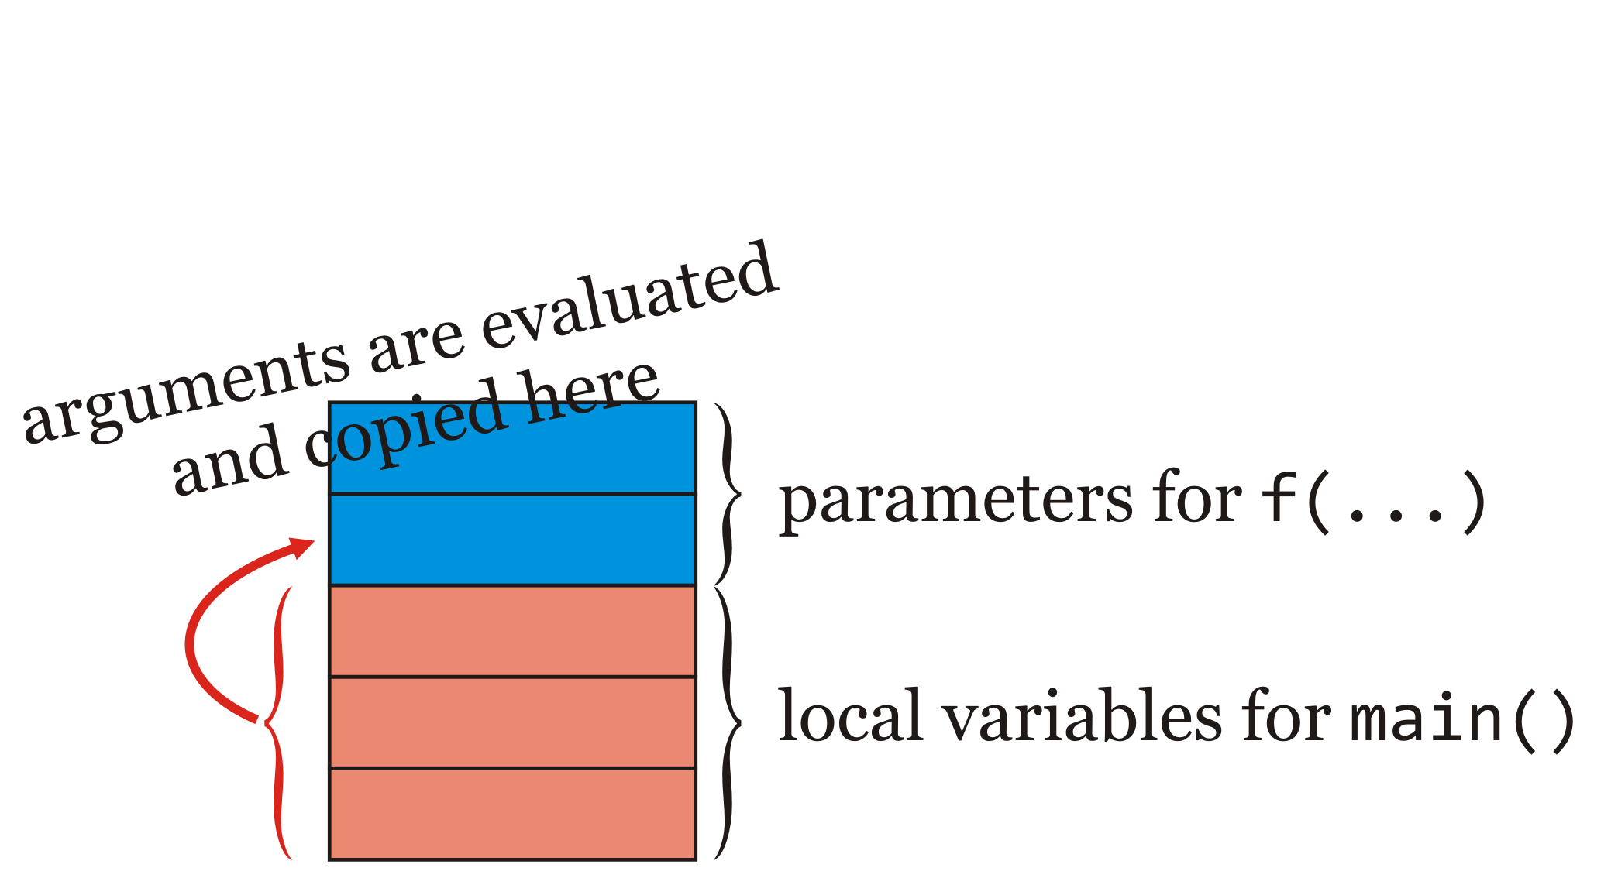
Pass-by-value
As we have seen, when calling a function, the value of the arguments are copied to the appropriate location on the stack
  The parameters are variables local to the function
  The function can treat the parameters just like local variables

Slide 7
Pass-by-value
Compare these two:
  If an array is passed as an argument, only the address is passed
    It doesn’t matter if you pass an array of capacity 1 or 1 million
Question: Can we pass primitive data types in a manner similar to arrays?
  Answer: As you may guess, yes

Slide 8
Pass-by-reference
If a parameter is prefixed by an &, this indicates the argument is passed-by-reference
  Arguments are restricted to lvalues: something that can be assigned
    E.g., variables and array entries
  The argument is not copied, but rather, the parameter identifier becomes an alias for the argument
  Any change to the parameter changes the original argument

Slide 9
Pass-by-reference
Example:
    void reset( int &n );
    void reset( int &n ) {
    n = 0;
    }
Any argument is passed by reference
  A change to the parameter n also changes the argument
    int main() {
    int k{42};
    reset( k );
    std::cout << k << std::endl;
    return 0;
    }
Output:
0

Slide 10
Pass-by-reference
Only those items that can appear on the left-hand side of assignment statements can be passed by reference:
    int main() {
    int k{42};
    reset( k + 1 );
    std::cout << k << std::endl;
    return 0;
    }
example.cpp: In function 'int main()':
example.cpp:12:11: error: invalid initialization of non-const reference of type 'int&' from an rvalue of type 'int'
reset( k + 1 );
^
example.cpp:6:6: error: in passing argument 1 of 'void reset(int&)'
void reset( int &n ) {
^

Slide 11
Pass-by-reference
When you perform a std::cin statement, the second operand is passed by reference, so it can be modified:
    int main() {
    int k;
    std::cout << "Enter an integer: " << std::endl;
    std::cin >> k;
    std::cout << k << "*" << k << " = " << (k*k)
    << std::endl;
    return 0;
    }

Slide 12
Applications
We will look at four applications:
  Having multiple return values
  Verifying if a returned value is valid
  Updating a variable subject to conditions

Slide 13
Application: multiple return values
Suppose you need both the minimum and maximum of three values:
    void min_max( int a, int b, int c, int &min, int &max ) {
    if ( a < b ) {
    min = a;
    max = b;
    } else {
    min = b;
    max = a;
    }
    if ( c < min ) {
    min = c;
    } else if ( c > max ) {
    max = c;
    }
    }

Slide 14
Application: Is a returned value valid?
Suppose you want to check if arithmetic calculations are valid
  All integers are valid return values, yet under- or overflow may occur
    int add( int a, int b, bool &invalid_result ) {
    int result{ a + b };
    // The result is invalid if
    // 'a' and 'b' are positive yet 'a + b' is negative, or
    // 'a' and 'b' are negative yet 'a + b' is positive
    invalid_result = ( ((a > 0) && (b > 0) && (result <= 0))
    || ((a < 0) && (b < 0) && (result >= 0)) );
    return result;
    }
    int multiply( int a, int b, bool &invalid_result ) {
    int result{ a*b };
    // The result is invalid if '(a*b)/b != a' for a non-zero 'b'
    // - a*0 = 0 for all possible values of 'a'
    invalid_result = ( (b != 0) && (result/b != a) );
    return result;
    }

Slide 15
Application: Updating a variable
Suppose you want to increment a variable that cycles through an array of a given capacity:
    std::size_t k{0};
    while ( some-condition ) {
    // Do something...
    // Move 'k' to next entry of an array, but
    // if we are at the end of the array, go back to 0
    if ( k == (array_capacity - 1) ) {
    k = 0;
    } else {
    ++k;
    }
    }

Slide 16
Application: Updating a variable
Instead, let’s write a function that increments its argument appropriately:
    void increment_and_cycle( std::size_t &n, std::size_t capacity ) {
    if ( n == (capacity - 1) ) {
    n = 0;
    } else {
    ++n;
    }
    }
Now the original code is much more clear:
    std::size_t k{0};
    while ( some-condition ) {
    // Do something...
    increment_and_cycle( k, array_capacity );
    }

Slide 17
Return-by-reference
It is even possible to return by reference:
    int &f( int &n );
    int &f( int &n ) {
    std::cout << "In f(1): " << n << std::endl;
    n = 360;
    std::cout << "In f(2): " << n << std::endl;
    return n;
    }
Now consider
    int main() {
    int k{42};
    f(k) = 91;
    std::cout << k << std::endl;
    return 0;
    }

Slide 18
Return-by-reference
Is this valid? Why or why not?
    int &f();
    int &f() {
    int n;
    return n;
    }
Now consider what would happen if we tried:
    int main() {
    f() = 91;
    return 0;
    }

Slide 19
Return-by-reference
When you call a std::cout statement, std::cout is passed by reference, and once again returned by reference, which is why you multiple items being printed:
    int main() {
    std::cout << "3 + 4 = " << (3 + 4) << std::endl;
    return 0;
    }
      Yes, std::cout; is a valid statement—it does nothing
    ((std::cout << "3 + 4 = ") << (3 + 4)) << std::endl;
    ( std::cout << (3 + 4)) << std::endl;
    std::cout << std::endl;
Returned by reference
    std::cout;

Slide 20
In this course…
In this course, we will only use pass-by-reference
  We generally will not use reference local variables
  We will see, but not use, return-by-reference

Slide 21
Summary
Following this lesson, you now
  Know how to create an alias or reference to another assignable variable
  Understand that a parameter can be an alias to the argument
    This is know as pass-by-reference
  Are aware of numerous applications of pass-by-reference
    Returning more information than one return value allows
  Know that there is also a return-by-reference

Slide 22
References
[1] No references?

Slide 23



Colophon
These slides were prepared using the Georgia typeface. Mathematical equations use Times New Roman, and source code is presented using Consolas.
The photographs of lilacs in bloom appearing on the title slide and accenting the top of each other slide were taken at the Royal Botanical Gardens on May 27, 2018 by Douglas Wilhelm Harder. Please see
https://www.rbg.ca/
for more information.

Slide 24
Disclaimer
These slides are provided for the ece 150 Fundamentals of Programming course taught at the University of Waterloo. The material in it reflects the authors’ best judgment in light of the information available to them at the time of preparation. Any reliance on these course slides by any party for any other purpose are the responsibility of such parties. The authors accept no responsibility for damages, if any, suffered by any party as a result of decisions made or actions based on these course slides for any other purpose than that for which it was intended.

